Slide 1

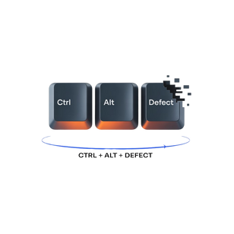
Final Project:
Software Testing on Swag Labs
Team 53

Slide 2

Introduction:
Project Goal: To demonstrate the importance of testing during the purchase process on Swag Labs.
SubtitleScope: Functional, Non-Functional (Performance, Security and usability)

Slide 3

Team & roles:
Team Lead: Omar Ali
QC: Abanoub melad
Qc: Rana ahmed
Qc: ahmed Nashat
qc: Sama elsawey
Tools for collaboration: Jira, GitHub,Excel

Slide 4

Testing Approach:
Manual Testing
Requirements → User Stories with Acceptance Criteria → Test Cases → Bug Reports → Coverage Report
Total Test Cases: 161
Coverage: 100% for critical scenarios

Slide 5
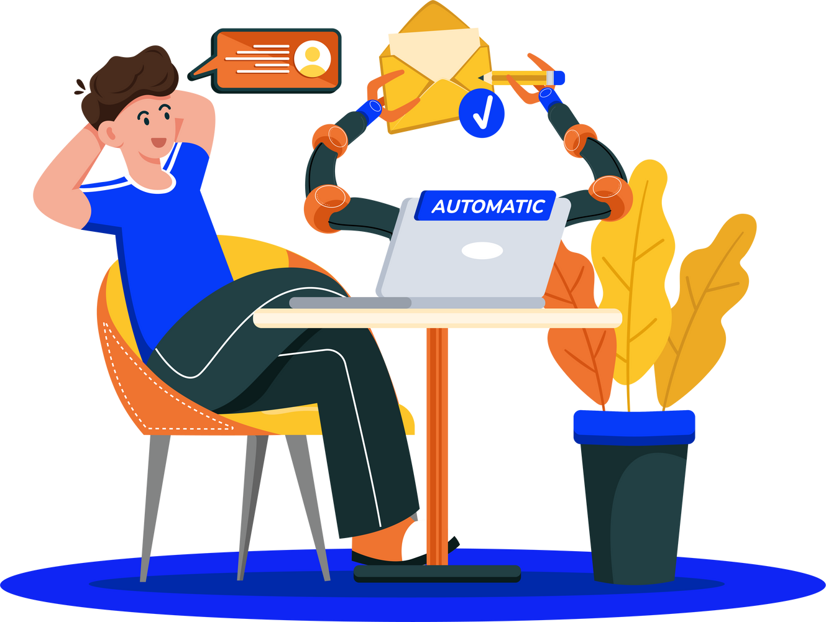
Automation Testing:
Tools: Selenium, Maven, TestNG
Design Patterns: Page Object Model (POM)
Fluent Interface for readable steps
Dynamic Data: JSON
Focus: End-to-End Scenarios

Slide 6
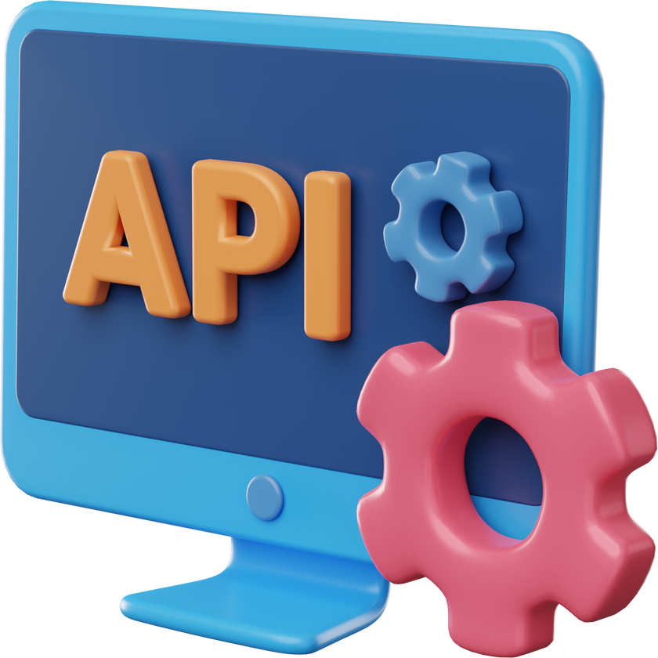
API Testing:
Tool: Postman
Methods: GET, POST, PUT, DELETE
TestCases documented in Excel

Slide 7

Tools & Technologies:
Selenium, TestNG, Maven
Postman for API Testing
Jira for task management
GitHub for version control

Slide 8

Challenges & Solutions:
Challenge: Website update caused 5-day downtime
Solution: Adjusted timeline, learned automation from YouTube
Challenge: Late start on automation
Solution: Team collaboration and resource sharing

Slide 9


Results:
Manual Testing: 161 test cases executed
Automation:Key end-to-end flows automated
API Testing: All CRUD operations tested
Bug Reports: Documented and tracked in Jira

Slide 10


Future Improvements:
CI/CD Integration
More advanced performance and security testing
Expand automation coverage

Slide 11

Conclusion:
Importance of testing in ensuring smooth purchase flow
Team collaboration and adaptability were key to success

Slide 12
Thank you

